Slide 1
Coptic Lesson 7
The Rule of the Coptic JINKIM

Slide 2
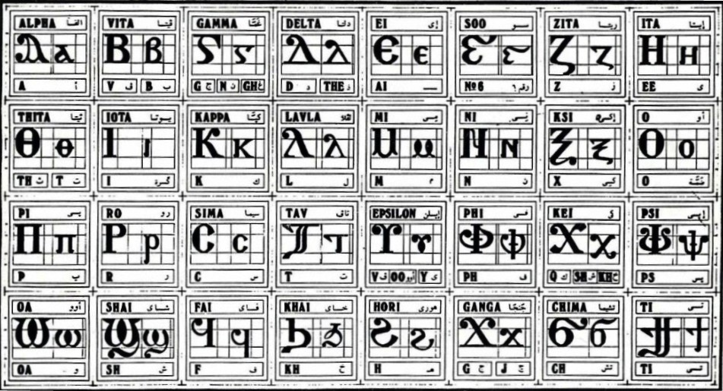
Coptic Alphabets

Slide 3
Review
^ x u f ou
L : P V ' [
S q J G H
D Y R <
A B E Z I K M N O C T W }

Slide 4
Questions
f
f
Fai
,
K, sh, kh
Kei
g
G, gh, n
Ghamma
U
oo, v, y
Epsilon
]
ti
ti
;
th, t
Thita
[
ch
Chima

Slide 5

What is the Jinkim?
A phonetic symbol or accent mark:
` a Éa Èa
It was not part of the original language but was added to help readers pronounce the words.
When the Jinkim is over a consonant, a short "e" sound proceeds the letter.
Example: `r = er
When the Jinkim is over a vowel, that letter must be pronounced by itself, thereby splitting the word into various syllables.

Slide 6
JINKIM over Consonants
`k = ek
`m = em
`n = en
`d = ed
`nnoub = the gold
`mMaria = of Mary
`nNou] = of God
`k`cmarwout = you are blessed

Slide 7
JINKIM over Vowels
7 Coptic Vowels: a e y i o w u
A`aron = Aaron
Mari`a = Mary
`ebol = out, away
pek`ypoc = your garden

Slide 8

Questions: What is the Jinkim?
Which way is correct?
` z Éz Èz
Was it part of the original language?
When the Jinkim is over a consonant, a short ____ sound proceeds the letter.
When the Jinkim is over a vowel, that letter must be pronounced _____________.

Slide 9
JINKIM Practice
`f
ef
`l
el
`p
ep
`q
ekh
`t
et
`;
eth, et
`v
eph

Slide 10
Coptic Jinkim Reading
``nte nane `nje `nran `nta
`wou oui `ejen jaji `fsyp
`ew ou`w `cnau `amoi af``i
ouai ouoh houi ou`w `mmoc
nof `p[oic tote `wou pi`wou
`erw] `viom `sne cen] `ement
`chimi rama`o `cnof ]`aco ]`pla

Slide 11
Practice the JINKIM
Af``i = He came
`eron = unto us
`amyn = Amen
`nte = of
`agioc = Holy (Greek)
`,ouab = Holy (Coptic)
`vran = the name
pi`wou = the glory
Ei`e`i = I shall go
sep`hmot = thank you

Slide 12
Announcement

Slide 13

Oujai qen `P[oic

